Slide 1
Temporal Databases
From Handbook of Temporal Reasoning in Artificial Intelligence
By Jan Chomicki & David Toman
Presented by Leila Jalali
CS224 presentation

Slide 2

Temporal databases
Some data may be inherently historical
e.g., medical or judicial records
Temporal databases provide a uniform and systematic way of dealing with historical data
Considerable effort has been expended on the development of temporal databases and query languages
TQuel [Snodgrass87], TSQL2 [Snodgrass95], SQL/Temporal [Snodgrass96]
But none of them has been adopted as the standard language of temporal databases in practice
No established the theoretical foundations for management of time-dependent data
No universal consensus on how temporal features should be added to the standard relational model
Notes:
ATSQL [Snodgrass95]

Slide 3
Outline
The fundamental notions of temporal databases
A formal foundation for temporal data models
How to introduce time into the relational model
Query languages for temporal databases
Temporal extensions of SQL
Limitations of simple linearly-ordered, first-order temporal data models
More complex models of time

Slide 4
Structure of time
They used a very simple notion of time in this chapter:
a linear ordering of time instants
In addition to linear ordering, we may consider:
Discrete or dense
Bounded or unbounded
Single dimensional or multi-dimensional
Linear or non-linear
Notes:
They used a very simple notion of time in this chapter
This is different from the domain of intervals
Linear or non-linear: single line or tree like
the majority of the results in this chapter that we are going to talk about continue to hold independent of the above choices

Slide 5
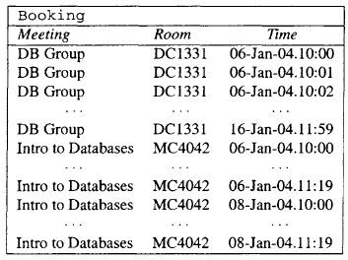
The time stamp model
All the tuples in a relation have an additional temporal attribute
Example: Booking (meeting, room, time)
A tuple (m,r,t) denotes the fact that:
meeting m is in room r at time t
Notes:
How to represent the notion of time in a relational database

Slide 6
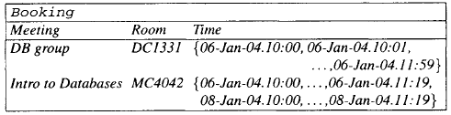
Temporal attribute
Single-dimensional: temporal relations were allowed only a single temporal attribute
Multiple dimensional: with each tuple in a relation there can be more than one temporal attribute
Example: two kinds of time are stored: the valid time (when a particular tuple is true) and the transaction time (when the particular tuple was inserted/deleted in the database)
Non-1NF: can be flattened to obtain the 1NF
Notes:
Can be flattened to obtain the 1NF

Slide 7

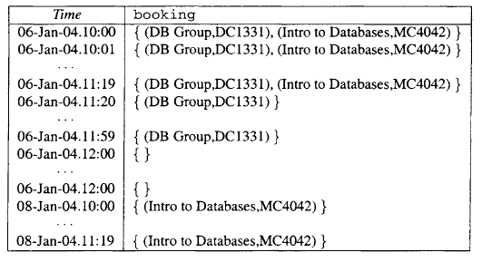
The snapshot model
Different view from the time stamp model (of the same data)

Slide 8


Relational database histories
A history over a database schema p and a data domain D is a sequence H : (Do,..., Dn) of database instances such that:
1. all the states Do , . . . , Dn share the same schema p and the same data domain D
2. Do is the initial instance of the database
3. Di results from applying an update to Di-1, for i > 1
…
time
Do
D1
D2
…

Slide 9
Temporal database design
Reconstruction of Jensen’s formal framework [Jensen96]
Based on the notion of temporal functional dependency:
Example: the temporal FD
means every meeting is held in a single room at any given time
Several advantages: can use the classical notions of FD inference, dependency closure, normal forms, mix temporal and non-temporal FDs
A temporal FD holds in a snapshot temporal relation DB if the (classical) FD holds in every snapshot of DB
Notes:
X → Y if and only if each X value is associated with precisely one Y value.

Slide 10




Multiple dimensions
How to express two temporal dimensions using temporal FD:
valid time (VT)
transaction time (TT)
3 kind of temporal FDs:
Transaction time:
Valid time:
Bitemporal:
Example: means the record at any time of the room booked for a meeting at any time is uniquely determined
Disadvantage:
Can no longer talk about, e.g., temporal keys, but only about valid-time, transaction-time or bitemporal keys
The framework becomes so complicated that it is unlikely to be of any use
Notes:
X is held in Y at any given time

Slide 11
Temporal queries
Databases are inherently first-order structures
Temporal extensions first-order logic
Query: using a natural first-order query language
The answer: the set of tuple that make the query true in the given relational database
Examples:
find all meetings that always meet in the same room
find all rooms in which the last meeting was 'DB group'

Slide 12
Temporal logic
Historically, many different variants of temporal logic based on different sets of connectives have been developed [Gabbay94]
Some connectives are well-known and have been universally accepted:
sometime in the future
always in the future
In general any appropriate first-order formula in the language of the temporal domain can be used to define a temporal connective

Slide 13

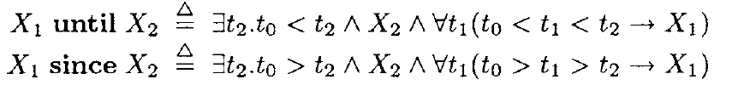
First order temporal logic
First they define the first order language of Tp extended with propositional variables Xi :
Then use it to define a (k-ary) temporal connective:
an O-formula with exactly one free variable t0 and k propositional variables X1,.., Xk
They assume ti is the only temporal variable in the formula to be substituted for Xi
Example: common binary temporal connectives:

Slide 14
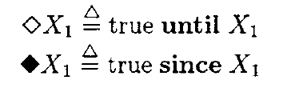
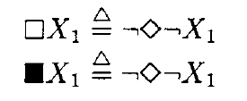


Temporal connectives
Other temporal connectives:
Sometime in the future:
Sometime in the past:
Always in the future:
Always in the past:
Next:
Previous:

Slide 15




First order temporal logic
: A set of temporal connectives , e.g. {since, until}
: First order temporal logic (FOTL) over a schema
:

Slide 16

Examples
How to use temporal connectives to formulate queries:
Find all rooms in which the last meeting was 'DB group‘:
Find all meetings with a scheduled break:
Sometime in the future:
Sometime in the past:
Always in the future:
Always in the past:

Slide 17
Temporal extensions of SQL
A point based extension of SQL: SQL/TP [Toman97]
The syntax and semantics of SQL/TP are defined as a natural extension of SQL
An additional data type based on the point-based temporal domain Tp (i.e., a linearly ordered set of time instants)
Notes:
Up to this point query languages based on logic
Now temporal extensions of more practical query languages

Slide 18
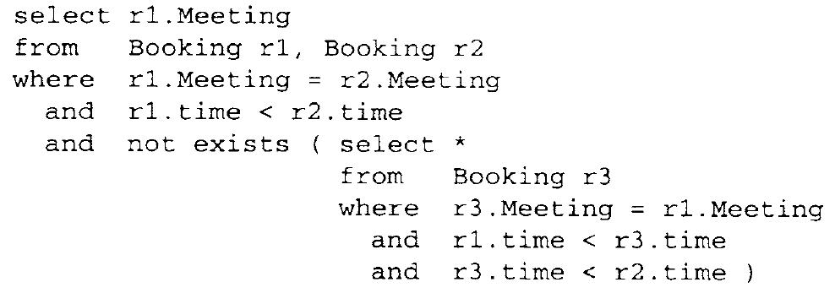
SQL/TP Example
List all meetings with a scheduled break :
Notes:
Up to this point query languages based on logic
Now temporal extensions of more practical query languages

Slide 19
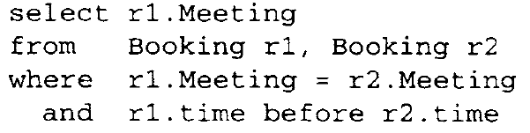
Extensions of SQL based on interval based language
TSQL2 or SQL/Temporal [Snodgrass95]
Time attributes range over intervals and the before relationship denotes the before relationship between two intervals

Slide 20
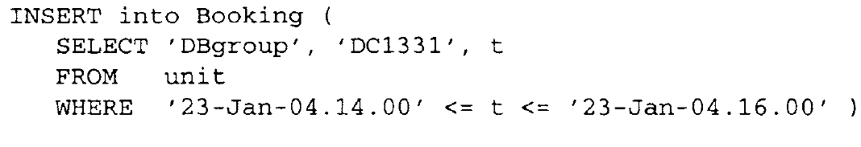
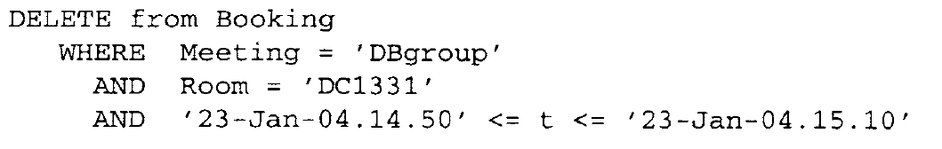
Updating temporal databases
Insertion: a new booking for a room for a meeting
Unit is an auxiliary table that contains a single tuple
The inner query produces:
Deletion: Creating 20 minute break in the middle of meeting

Slide 21
Complex structure of time
Complex structure of time: more complex than linearly ordered sets of time instants
Natural numbers, integers, reals
Additional structures: durations, temporal distances, periodic sets
Impact on integrity constraints : more complex constraint dependencies
Impact on query languages (use new predicate symbols in the same way the linear order < symbol has been used so far)

Slide 22
Beyond…
Beyond the first order logic
More expressive power than first order logic
Beyond the Closed World Assumption
Closed World Assumption: temporal databases hold complete information about truth
An alternative: to treat the relational structures representing temporal databases as incomplete specifications and use the Open World Assumption to answer queries
Notes:
query processing essentially reduces to the satisfiability problem for formulas in these languages which, in all the cases, is highly undecidable.

Slide 23
Conclusion
Issues not Covered in the chapter:
Conceptual Modeling of Temporal Data
Physical Design for Temporal Databases
Time Series and Temporal Data Mining
Research directions that are closely related to temporal data management:
Spatio-Temporal Databases
Streaming Data Management
Time in Document Management and XML
Notes:
combine time and space
query processing over sequences of data items arriving over time (data streams),
evolution of a document or of a set of documents over time

